Slide 1




PL/SQL
-Triggers & Procedures

Slide 2
OUR TEAM
Aditya Dighe
Vinit Dhoot
Srushti Bhuyar
Vedant Dhamane
Gargi Dandare

Slide 3
Before We Begin....

Slide 4
Let's Have Some Prerequisites

Slide 5
Prerequisites Required
Domain Specific Languages
Procedural Languages
Relational Databases
Programming in SQL
PL/SQL Basic Syntax & Variables

Slide 6


~Prerequisites
Domain Specific Programming Language : Salient Features
A language speciaised to a particular application domain....
Optimized for specific class of problems.
Is usually not useable in other domains
Examples....
HTML 5

Slide 7


~Prerequisites
When is a Programming Language classifed as a Procedural Language ?
Code Written in the form of sequence of instructions.
Programmer / User Specifying “what to & how to do" step by step.
Sequential Execution of Instructions
Examples....

Slide 8
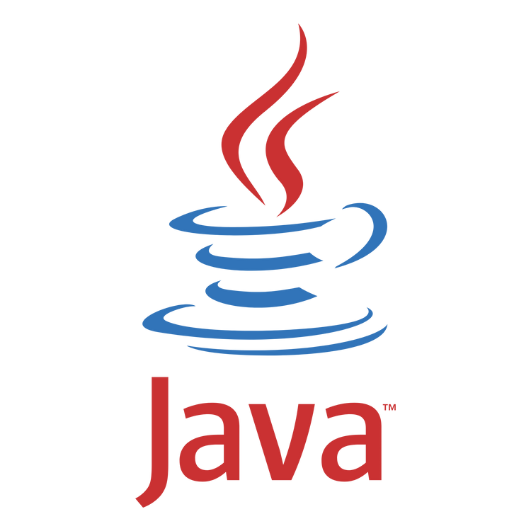
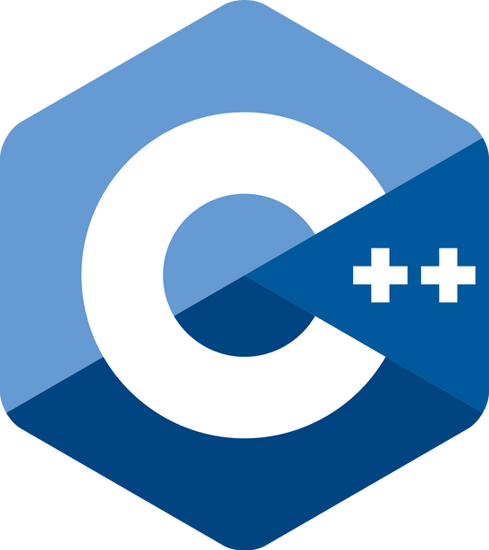
~Prerequisites
Are the Below 2 Languages Procedural ?
They are Object Oriented Languages

Slide 9
~Prerequisites
What's a Relational Database ?
A relational database is a type of database that stores and provides access to data points that are related to one another.
In a relational database, each row in the table is a record with a unique ID called the key. A crude example :- Roll Nos !

Slide 10
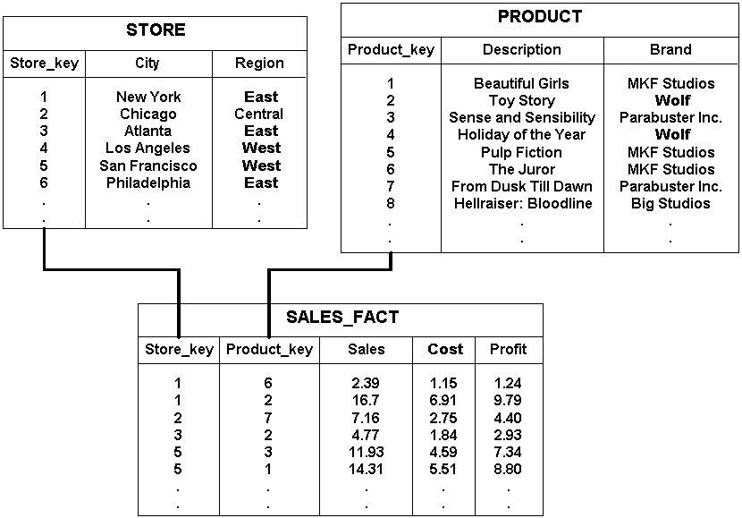
~Prerequisites
Example
All prices in US$
Source : Oracle

Slide 11
~Prerequisites
What's SQL ?
SQL or Standard Querry Language, is a standard language for storing, manipulating and retrieving data in databases.
It's a Non-Procedural, Domain Specific Language
What makes it Non-Procedural ?
Here's an example code....

Slide 12
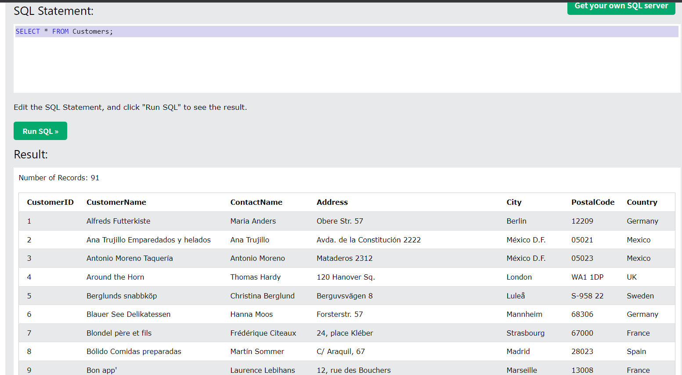
What does SELECT * FROM Customers do here ?

Slide 13
INTRO
What's PL/SQL ?
Procedural Language Extension to Structured Query Language or in short
PL/SQL is a block-structured language that enables developers to combine the power of SQL with procedural statements.
Advantages of Procedual Language Extension to SQL ?
Makes Code
-Much More Readable
-Makes it Reusable
-Improves Modularity
-Improves Maintainability.

Slide 14
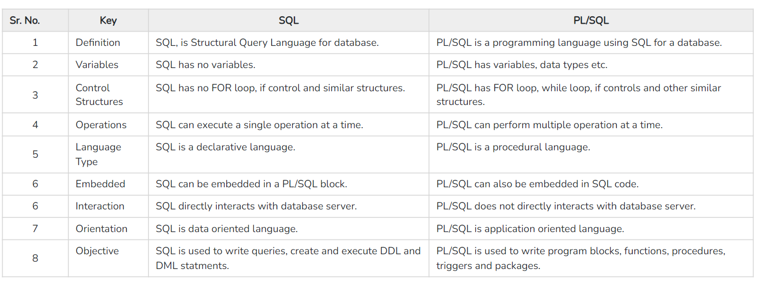
INTRO
PL VS SQL

Slide 15
TRIGGERS IN PL/SQL
Triggers are stored programs, which are automatically executed or fired when some events occur.

Slide 16
TRIGGERS : USE
Database Manipulation:
-When something is deleted, updated or inserted
Database Defined:
-When database is created
Database Operation
-When Logon, Logoff shutdown or startup happens

Slide 17
USES OF TRIGGERS
Generating some derived column values automatically
Enforcing referential integrity
Event logging and storing information on table access
Auditing
Synchronous replication of tables
Imposing security authorizations
Preventing invalid transactions

Slide 18
PROCEDURES
Prequisite: What is a SubProgram?
A subprogram is a program unit/module that performs a particular task. These subprograms are combined to form larger programs.
What are Procedures ?
Procedures are a subprogram, just like Functions, however unlike Functions in PL/SQL, procedures lack any return value.

Slide 19

THANK YOU

